Slide 1
History of Database Systems

Slide 2
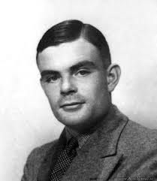

Alan Turing
A British pioneering computer scientist, mathematician, logician, cryptanalyst, mathematical biologist.
Proposed the Turing machine which provides formalization of the concepts of algorithm and computation, a model of a computer.
Considered to be the father of theoretical computer science and artificial intelligence.
Prosecuted in 1952 for homosexual acts
Nobel Prize of computing−ACM Turing Award is the highest annual award in computer science since 1966, now it comes with US$1 million from Google.
June 23 1912
June 7, 1954

Slide 3
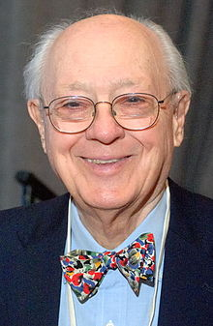
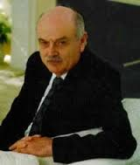
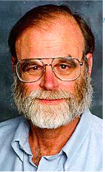

Turing Award for DB People
C. Bachman
Dec 11, 1924
Turing Award
1973 (age 49)
E.F. Codd
Aug.23,1923
Apr.18,2003
Turing Award
1981 (age 58)
Jim Gray
Jan 12, 1944
Jan 28, 2007
Turing Award
1998 (age 54)
M. Stonebraker
Oct 11, 1943
Turing Award
2014 (age 71)

Slide 4
Data Models
Hierarchical Model IMS 1967
Network Model IDMS 1966
Relational Model 1970
Ingres (1976), System R (1977)
Nested Relational Model
Object Models
Object Relational Model
XML Model
NoSQL Models
Notes:
IBM Information Management System (IMS)

Slide 5
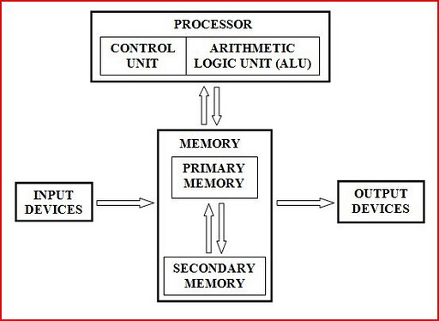
Computers and Operating Systems
A computer consists of:
One or more processors
Main memory
Disks
Various input/output devices
Managing all these components requires a layer of software – the operating system

Slide 6


The Unix System Structure
Users
Application Programs
User Mode
Software
User Interface (Shell)
Operating System
Kernel Mode
File System
Hardware
CPU
Memory
Disk
I/O
File System Calls:
open(), close(), read(), write(), lseek(), stat(), fstat()
Notes:
System calls

Slide 7
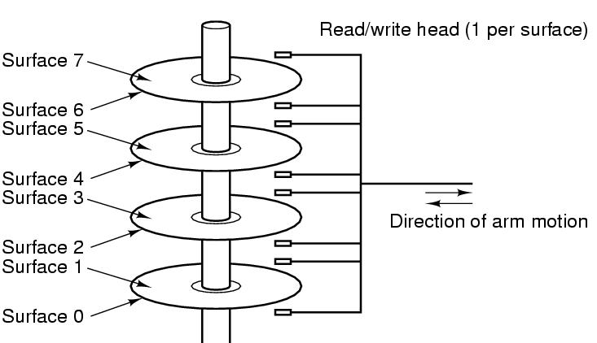
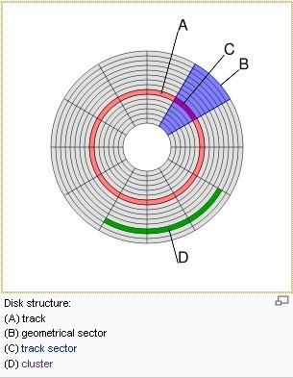
Disk
Disk sector/block address: <Surface#, Track#, Section#>
Figure 1-10. Structure of a disk drive.

Slide 8
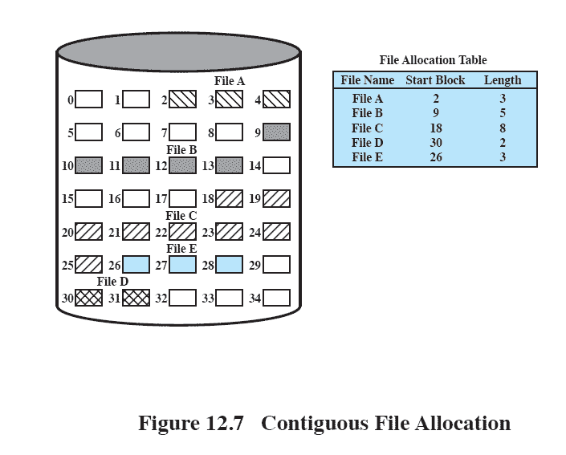
Contiguous File Allocation
Multiple blocks can be read in at a time to improve I/O
External fragmentation will occur
Difficult to find contiguous blocks Need to perform compaction

Slide 9
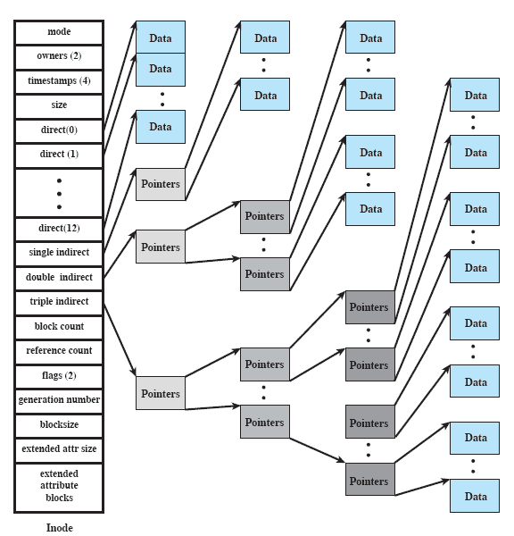
Unix/Linux Inode and File Structure
Notes:
The attributes of the file as well as its permissions and other control information
are stored in the inode. The exact inode structure varies from one UNIX
implementation to another. The FreeBSD inode structure, shown in Figure 12.16 ,
includes the following data elements:
• The type and access mode of the file
• The file’s owner and group-access identifiers
• The time that the file was created, when it was most recently read and written, and when its inode was most recently updated by the system
• The size of the file in bytes
• A sequence of block pointers, explained in the next subsection
• The number of physical blocks used by the file, including blocks used to hold indirect pointers and attributes
• The number of directory entries that reference the file
• The kernel and user-settable flags that describe the characteristics of the file
• The generation number of the file (a randomly selected number assigned to the inode each time that the latter is allocated to a new file; the generation number is used to detect references to deleted files)
• The blocksize of the data blocks referenced by the inode (typically the same as, but sometimes larger than, the file system blocksize)
The size of the extended attribute information
• Zero or more extended attribute entries
The blocksize value is typically the same as, but sometimes larger than, the file
system blocksize. On traditional UNIX systems, a fixed blocksize of 512 bytes was
used. FreeBSD has a minimum blocksize of 4,096 bytes (4 Kbytes); the blocksize
can be any power of 2 greater than or equal to 4,096. For typical file systems, the
blocksize is 8 Kbytes or 16 Kbytes. The default FreeBSD blocksize is 16 Kbytes.
Extended attribute entries are variable-length entries used to store auxiliary
data that are separate from the contents of the file. The first two extended attributes
defined for FreeBSD deal with security. The first of these support access control
lists; this is described in Chapter 15 . The second defined extended attribute supports
the use of security labels, which are part of what is known as a mandatory
access control scheme, also defined in Chapter 15 .
On the disk, there is an inode table, or inode list, that contains the inodes of
all the files in the file system. When a file is opened, its inode is brought into main
memory and stored in a memory-resident inode table.

Slide 10
The Era before DB
Business data needed to be stored persistently and queried on the disk
OS provided file systems and system calls to access files on the disk
A file system is a method for storing and organizing files and the data they contain to make it easy to find and access them
Programing languages supports storage and retrieval of records on the disk so that programmers could write File Processing Systems for various business data management
A file processing system is a collection of files and programs that access/modify these files
Notes:
File processing systems was an early attempt to computerize the manual filing system that we are all familiar with

Slide 11
General Problems
Various file processing systems had identical way to store and retrieve data, all that differed were the details of the input and output operations, which resulted in poor programming productivity and correctness
Records in a file may have relationship with records in other files, programing such a system is quite complex and difficult to maintain.
Changes of the system required long term planning and often risked introducing faults into systems that were known to work correctly.
Such systems separated the users of the data from the data itself
Notes:
requiring them to use technical staff as intermediaries as there was no way of submitting ad hoc querie

Slide 12
Specific Problems
Business office, Registration office, etc each has its own file processing system.
Data Redundancy: waste space, inconsistency (change address)
Difficulty in Accessing data: not convenient and efficient in file processing systems, need to write programs to get data
Limited Data Sharing or Data Isolation: data are scattered in various file processing systems.
Limited Concurrent Access: one program/process can access the file processing system at a time
Security Problems: programs are added in an ad hoc manner by different programmers
Notes:
requiring them to use technical staff as intermediaries as there was no way of submitting ad hoc querie

Slide 13
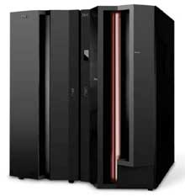
Hierarchical model
Initially implemented in a joint effort by IBM and North American Rockwell around 1965.
Resulted in the IMS family of systems and used on early IBM mainframe computers
Dominated during 1970s.

Slide 14
Hierarchical Model
The data is organized into a tree-like structure using records and links on disk rather than in memory
The data is stored as records which are collections of fields, with each field containing only one value. All attributes of a specific record are listed under an entity type.
Records are connected to one another through links.
Each record having one parent record and many children so that records' relationships form a tree-like model.
All attributes of a specific record are listed under an entity type.
This structure is simple but inflexible because the relationship is confined to a one-to-many relationship

Slide 15
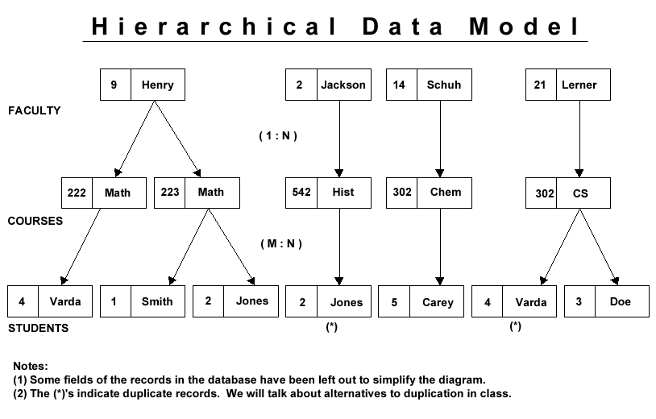
records
pointers
records
pointers

Slide 16
Hierarchical Model
Advantages:
Simple to construct and operate
Corresponds to a number of natural hierarchically organized domains, e.g., organization (“org”) chart
Language is simple:
Uses constructs like GET, GET UNIQUE, GET NEXT, GET NEXT WITHIN PARENT, etc.
Disadvantages:
Navigational and procedural nature of processing
Cannot capture the semantics of the data as Individual fields cannot identified by the system; a record is simply treated as a number of bytes into which data could be placed
Cannot represent many to many (M:N) relationships naturally
No data independence
Notes:
The purpose of a database management system is to
make life easier for the user and this is achieved by hiding
the complexities of the actual storage of the data from the
application software.
In a database system where true data
independence exists it is possible to restructure the physical
storage of data without invalidating any of the existing
applications.
Access to IMS data, for example, requires a programmer
to enter the database via a record at the top of the
hierarchy. If a programmer does not know which of the
top level records to select then the whole database must
be searched.

Slide 17
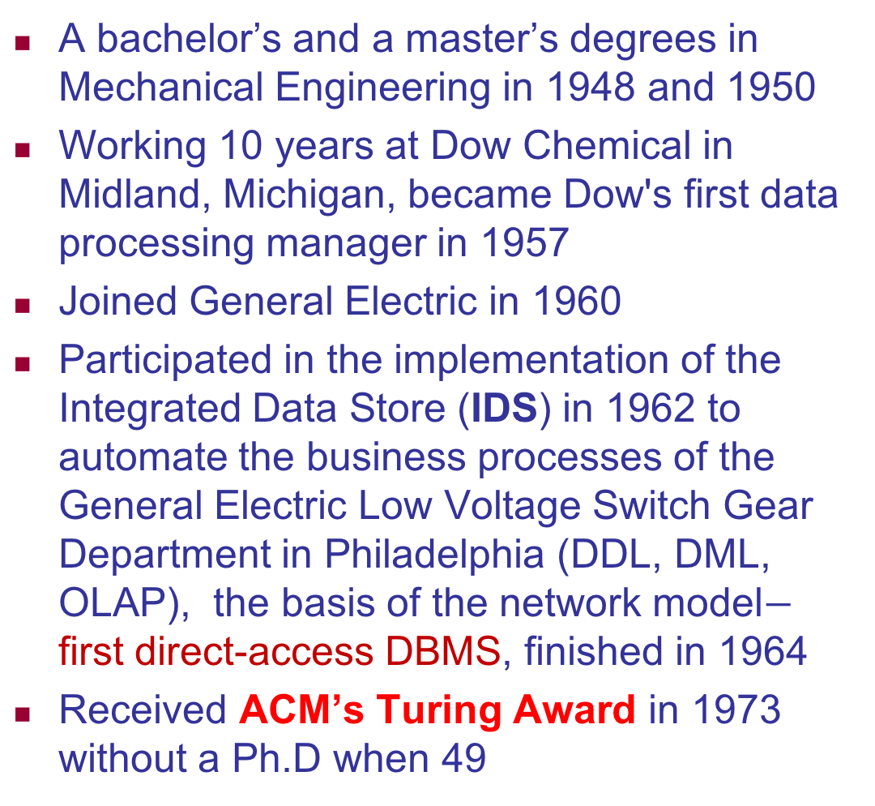
Network Model
A bachelor’s and a master’s degrees in Mechanical Engineering in 1948 and 1950
Working 10 years at Dow Chemical in Midland, Michigan, became Dow's first data processing manager in 1957
Joined General Electric in 1960
Participated in the implementation of the Integrated Data Store (IDS) in 1962 to automate the business processes of the General Electric Low Voltage Switch Gear Department in Philadelphia (DDL, DML, OLAP), the basis of the network model$−$ first direct-access DBMS, finished in 1964
Received ACM’s Turing Award in 1973 without a Ph.D when 49
Charles Bachman
born Dec 11, 1924

Slide 18
The Integrated Data Store (IDS)
At the start of the 1960s computer science was beginning to emerge as an academic field, but its early efforts focused on programming language design, theory of computation, numerical analysis, and operating system design.
Like modern DBMS, IDS explicitly stored and manipulated metadata about the records and their relationships, rather than expecting each application program to understand and respect the format of every data file it worked with.
It could enforce relationships between different record types, and would protect database integrity. Database designers would specify indexes and other details of record organization to boost performance based on expected usage patterns.
Notes:
The efficient and flexible handling of large collections of structured data was the central challenge for what we would now call corporate information systems, and was then called business data processing.
However the first versions it did not include a
formal data manipulation language.
During the late 1960s the ideas Bachman created for IDS were taken up by the Database Task Group of CODASYL, a standards body for the data processing industry best known for its creation and promotion of the COBOL language. Its 1969 report drew heavily on IDS in defining a proposed standard for database management systems, in part thanks to Bachman’s own service on the committee. In retrospect, the committee’s work, and a related effort by CODASYL’s Systems Committee to evaluate existing systems within the new framework, were significant primarily for formulating and spreading the concept of a “data base management system.”

Slide 19
Network Model
Introduced in 1960s by Charles Bachman (who wins 1973 Turing award)
Implemented by Honeywell in 1964-65 (IDS System).
Adopted heavily due to the support by CODASYL (Conference on Data Systems Languages)
Later implemented in a large variety of systems
IDMS (Cullinet - now Computer Associates),
DMS 1100 (Unisys),
IMAGE (H.P. (Hewlett-Packard)),
VAX -DBMS (Digital Equipment Corp., next COMPAQ, now H.P.).

Slide 20
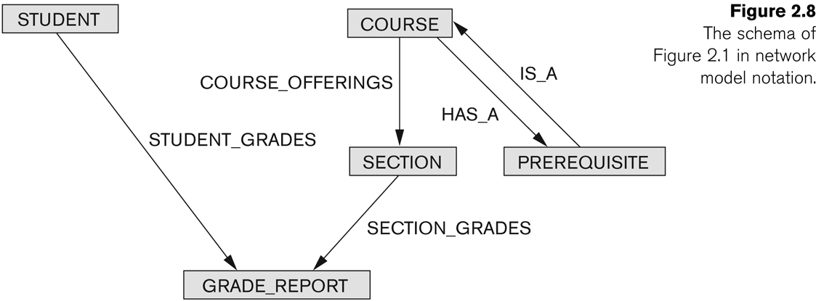
Network Model
The data is organized into a graph (lattice) structure.
each parent can have many children
each child can also have many parents.
N:M

Slide 21
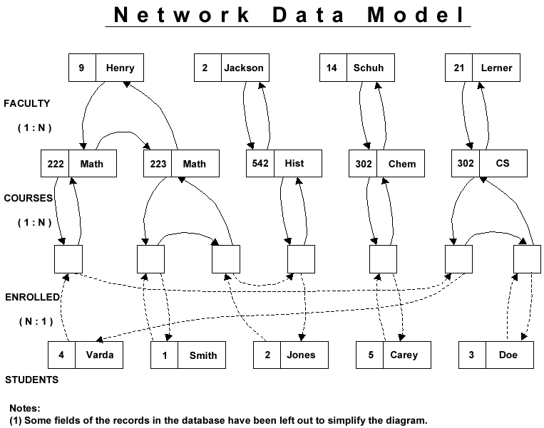
records
pointers
records
pointers
records
pointers
records

Slide 22
Network Model
A flexible way of representing entities and their relationships
Allows each record to have multiple parent and child records, forming a generalized graph structure.
This property applies at two levels:
the schema is a generalized graph of record types connected by relationship types
the database itself is a generalized graph of record occurrences connected by relationships.
Cycles are permitted at both levels.
In comparison to the hierarchic model, it allows a more natural modeling of relationships (M:N) between entities.

Slide 23
Network Model
Advantages:
Network Model is able to model complex relationships and represents semantics of add/delete on the relationships.
Can handle most situations for modeling using record types and relationship types.
Language is navigational; uses constructs like FIND, FIND member, FIND owner, FIND NEXT within set, GET, etc.
Programmers can do optimal navigation through the database.

Slide 24
Network Model
Disadvantages:
Navigational and procedural nature of processing
Database contains a complex array of pointers that thread through a set of records.
The semantics of data embedded in application programs and different sets of semantics could be applied by different applications.
Limited data independence
Little scope for automated “query optimization”
Notes:
Access to the database was typically performed on a record at a time basis with the programmer testing each
record retrieved to see whether or not it belonged in the result set.
CODASYL designers identify entry points to
the database via key hashing mechanisms or special relationships.

Slide 25
Network Model
Although it was widely implemented and used, it failed to become dominant for two main reasons.
IBM chose to stick to the hierarchical model with semi-network extensions in their established products such as IMS and DL/I.
It was eventually displaced by the relational model.

Slide 26
Relational Model
Born on the Isle of Portland in England
Studied mathematics and chemistry at Exeter College, Oxford
Worked for IBM as a mathematical programmer in 1948
Moved to Ottawa in 1953 for 10 years
Returned to US and received his doctorate in computer science from the University of Michigan in Ann Arbor in 1965
Edgar F. Codd
Aug.23,1923
Apr.18,2003

Slide 27
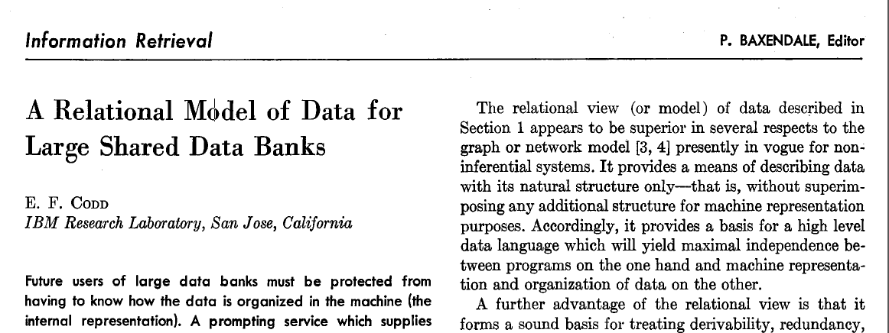
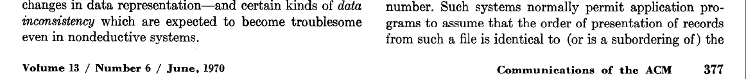
Relational Model
Worked at IBM's San Jose Research Laboratory
In the 1960s and 1970s he worked out his theories of data arrangement, issuing his paper "A Relational Model of Data for Large Shared Data Banks" in 1970, after an internal IBM paper one year earlier.
Edgar F. Codd
Aug.23,1923
Apr.18,2003

Slide 28
Relational Model
The need to increase data independence in data base system
to hide certain necessary storage and retrieval operations from the applications programmer
The need for a mathematical approach to data storage and retrieval
Just tell DBMS what to get rather than how to get
The need to support ad hoc query processing
Users can interactively submit a query and immediately receive an answer.
Notes:
both of hierarchical and network systems relied on the use of pointers between records, the programmers using them did not manipulate the pointers directly
The purpose of a database management system is to
make life easier for the user and this is achieved by hiding
the complexities of the actual storage of the data from the
application software
The user of a relational system is able to extract any results that follow from the
content of the raw data and not just those permitted by the database system. In order to facilitate this no aspect of a
relational system depends on the order in which the data is stored.
A specification was drawn up, this was transformed into a design and the design was used to construct a
program. This sequence, as everyone knows, is full of opportunities for introducing errors. It takes considerable
skill to write a program that performs correctly against a database and considerably more skill to demonstrate that the
program fulfils the requirements of the original specification.
This is equivalent to having an executable specification language.
The problem of ensuring that the query matches the real
world requirement remains but the problem of transforming
the query into executable code disappears.
Codd believed that users would no longer be satisfied with obtaining output
from a database on a daily basis following the off-line
execution of a query program, instead they would expect
to interactively submit a query and immediately receive an
answer. Provision of such a facility relies, to a certain
extent, on data independence and relational theory

Slide 29
Relational Model
FACULTY
F# | FNAME
2 | Jackson
9 | Henry
14 | Schuh
21 | Lerner
COURSES
C# | CNAME
222 | Math
223 | Math
302 | CS
302 | Chem
542 | Hist
STUDENT
S# | SNAME
1 | Smith
2 | Jones
3 | Doe
4 | Varda
5 | Carey
all data is represented in terms of tuples (records), grouped into relations (files)
FC
F# | C#
2 | 542
9 | 222
9 | 223
14 | 302
21 | 304
SC
S# | C#
1 | 223
2 | 223
2 | 542
3 | 304
4 | 222
4 | 304
5 | 302

Slide 30
Relational Model
IBM refused to implement the relational model in order to preserve revenue from IMS/DB.
Codd then showed IBM customers the potential of the implementation of its model, and they in turn pressured IBM.
Continued to develop and extend his relational model
IBM included in its Future Systems project a System R subproject in 1974, but put in charge of it developers who were not thoroughly familiar with Codd's ideas, and isolated the team from Codd.
Edgar F. Codd
Aug.23,1923
Apr.18,2003

Slide 31
Relational Databases
They did not use Codd's own Alpha language but created a non-relational one, SEQUEL(SQL), which has since become the standard relational database language.
System R with SQL started in 1974 and finished in 1977 as a prototype. Commercial products SQL/DS(1983) and DB2 (1983) for its mainframe computers
Received ACM’s Turing Award in 1981 when 58
Edgar F. Codd
Aug.23,1923
Apr.18,2003

Slide 32
Relational Databases
As the relational model started to become fashionable in the early 1980s, he fought a sometimes bitter campaign to prevent the term being misused by database vendors who had merely added a relational veneer to older technology. As part of this campaign, he published his 12 rules to define what constituted a relational database.
This made his position in IBM increasingly difficult, so he left to form his own consulting company with Chris Date and others
He died of heart failure at his home in Williams Island, Florida, at the age of 79 on 18 April 2003
Edgar F. Codd
Aug.23,1923
Apr.18,2003

Slide 33
Michael Stonebraker
A bachelor’s degree in Electrical Engineering from Princeton University in 1965
A master’s degree and Ph.D in Computer Science from the University of Michigan in 1967 and 1971
Joined UC Berkeley as an assistant professor in 1971
Started to work on the relational database system Ingres in 1974 based on E.F. Codd’s paper using a rotating team of student programmers using Unix machine and C language for 5 years.
Along with System R of IBM, show that it is possible to build a practical and efficient RDB.
Michael Stonebraker
Oct 11, 1943
Notes:
(Interactive Graphics and Retrieval System)

Slide 34
Network vs Relational
People thinks relational is an ideal model but not practical as its performance won’t be acceptable
It threatens the network standardization
After 5 years, ACM organized a workshop in 1974 to debate on the two models:
Network model: Bachman and his supporters
Relational model: Codd and his supporters
The debating improved the environment for relational model

Slide 35
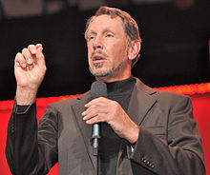
Oracle
born in the Lower East Side of Manhattan, New York City to a unwed Jewish mother, father was an Italian American US force pilot
After he contracted pneumonia at the age of nine months, his mother gave him to her aunt and uncle for adoption. He did not meet his biological mother again until he was 48
raised in a Reform Jewish home
was a bright but inattentive student, left the University of Illinois at Urbana-Champaign after his second year
attended the University of Chicago for one term, where he first encountered computer design
Larry Ellison
Born Aug 17, 1944
The third wealthiest
American citizen
Notes:
After Larry Ellison contracted pneumonia at the age of nine months, his mother determined that she was unable to care for him adequately, and arranged for him to be adopted by her aunt and uncle in Chicago

Slide 36
Oracle
at 20 years of age, moved to Northern California permanently and worked for Ampex Corporation during 1970s
one of his project was a database for CIA, called Oracle.
In 1977, inspired by E.F. Codd’s paper on relational database system, and founded consultancy Software Development Laboratories (SDL) with his friends, former coworkers Bob Miner and Ed Oates
Larry Ellison
Born Aug 17, 1944
The third wealthiest
American citizen
Notes:
Version 1 written in assembly language.
Part of Oracle Corporation's early success arose from using the C programming language to implement its products. This eased porting to different operating systems (most of which support C).
Oracle deploys so many important new features like virtual database, cluster database, cloud computing, in-memory database, and it support large databases

Slide 37
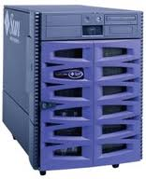
Oracle
It implemented a relational database system called Oracle on Unix operating systems
In 1978, Oracle Version 1 finished but not released.
In 1979, changed to Relational Software, Inc. and released its Oracle 2, run on PDP-11.
In 1982, changed to Oracle Systems Corp.
In 1990, big loss and layoff, almost bankrupted.
In 1995, changed to Oracle Corporation
In 2014, Forbes listed him as the third-wealthiest man in America and as the fifth-wealthiest person in the world, with a fortune of $52 billion.
Larry Ellison
Born Aug 17, 1944
The third wealthiest
American citizen
Notes:
Version 1 written in assembly language.
Part of Oracle Corporation's early success arose from using the C programming language to implement its products. This eased porting to different operating systems (most of which support C).
Oracle deploys so many important new features like virtual database, cluster database, cloud computing, in-memory database, and it support large databases

Slide 38
Informix
Founded as Relational Database Systems (RDS) in 1980 by Roger Sippl and Laura King
Released their Relational database product Informix (INFORMation on unIX) in 1981.
It grewed gradually and then changed to Informix Software
In 1995, purchased Illustra, focused on object-relational databases. It released the first object-relational databases Informix Universal Server in 1996, making it the first big three DB company (Oracle, Sybase, Informix) to offer built-in object relation support.
In late 1996, product releases began to fall behind schedule, with 10 key people joined Oracle in early 1997, it struggled
In April 2001 IBM bought from Informix the database technology.

Slide 39
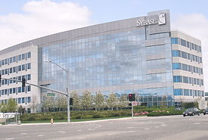
Sybase
Founded in 1984 by Mark Hoffman, Robert Epstein (a student on the INGRES project), Jane Doughty and Tom Haggin in Epstein’s home in Berkeley, California
In late 1986, Sybase shipped its first test programs, and in May 1987 formally released the SYBASE system, the first high-performance RDBMS for online applications.
Rather than having a vast central bank of data stored in a large mainframe computer, the SYBASE was the first to provide a client/server computer architecture. The server is called Sybase SQL Server

Slide 40
Sybase
Until 1993, Sybase was the fastest growing database company and the database industry's darling vendor, various new versions were released
Then it acquired Powersoft, the leading maker of development tools for client-server computing, which resulted in a loss of focus on its core database technology
In 1993, Sybase sold the rights to its database software running under the Windows operating system to Microsoft Corporation, which now markets it under the name "SQL Server.
It has changed to other business instead

Slide 41
Microsoft SQL Server
In 1989, Microsoft started to sell Sybase system and call it SQL Server 1.0 for IBM OS/2 system
In 1993, Microsoft released its operating system Windows NT, and it bought SQL Server code specific for Windows NT from Sybase and called it SQL Server 4.21
Gradually, it modified the system with its own code. In 2005, it completely rewrote SQL Server code and released its SQL Server 2005

Slide 42
Transaction Processing
After being turned down for the Air Force Academy, entered into UC Berkeley in 1961
Failed the Chemistry course in the first year and gave up studies.
Worked 6 months at General Dynamics
Came back to school to study Data Analysis and Discrete Mathematics
Graduated with both Mathematics and Engineering degree of bachelor.
Then worked on Multics with Ken Thompson in Bell Labs.
Studied again at UC Berkeley and obtained the first Ph.D in CS from UC Berkeley in three years in 1969.
Jim Gray
Jan 12, 1944
Jan 28, 2007

Slide 43
Transaction Processing
Worked in IBM on various database systems, IMS, System R, SQL/DS, DB2.
Invented transaction processing to make relational database system possible in the paper “Granularity of Locks and Degrees of Consistency in a Shared Data Base” in 1976. i.e., the famous ACID properties.
In 1993, Microsoft wanted to get into relational DB market and got him.
His term released MS SQL server 7.0
Received ACM’s Turing Award in 1998 for his work on Transaction Processing when 54
On January 28, 2007, during a short solo sailing trip to the Farallon Islands near San Francisco to scatter his mother's ashes, and was missing
Jim Gray
Jan 12, 1944
Jan 28, 2007

Slide 44
Relational Database Wars
IBM dominated the mainframe relational database market with its SQL/DS(1981) and DB2 (1983) database products, it delayed entering into mini and microcomputer.
Oracle, Sybase, Informix dominated mini and microcomputers
Oracle almost went bankrupt in 1990
Sybase was far ahead of Oracle and expanded rapidly, resulted in a loss of focus on DB and sold its DB software to Microsoft in 1993, which now markets it under SQL Server
Informix overtook Sybase between 1994-1997 and competed with Oracle, but its CEO landed in Jail in 1997 and Informix relational DB division was taken by IBM in 2001
Since then, Oracle enjoyed years of industry dominance

Slide 45
Relational DB History
Database Name | Year Released | Company
Oracle | 1979 | Oracle
Informix | 1981 | Informix
DB2 | 1983 | IBM
Sybase | 1986 | Sybase
SQL Server | 2005 | Microsoft

Slide 46
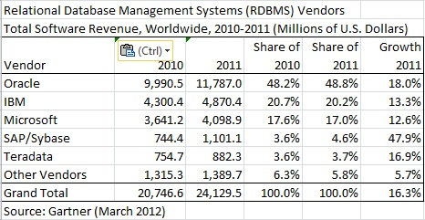
2011 Market Share

Slide 47
Market Shares in 2011
Oracle DB on Mini&Micro Computers 48.8%
IBM (DB2 database) on Mainframe 20.2%
Microsoft (SQL Server) on PC 17.0%
SAP/Sybase 4.6%
24 billions US dollar sales in 2011

Slide 48
MySQL
Initially released in 23 May 1995 by the Swedish company MySQL
The world second most widely used RDBMS
It was acquired by Sun Microsystems in 2008 for $1 billion, which was in turn acquired by Oracle Corporation in 2010.
The world's most popular open source database. With over 65,000 downloads per day
Popular choice of database for use in web applications (Linux, Apache, MySQL, Perl/PHP/Python)

Slide 49
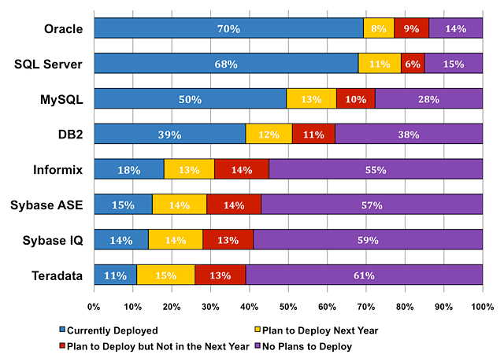
Database Installations in 2008

Slide 50
Microsoft Access
RBASE was the first relational database program for the PC, created by Wayne Erickson in 1981. He and his brother then incorporated the company, MicroRim, Inc. to sell the database, MicroRIM (Relational Information Management)
Privately funded and ultimately venture backed, the MicroRim database products achieved significant market share in the mid-1980s
Microsoft's first attempt to sell a relational database product was during the mid 1980s, when Microsoft obtained license to sell Rbase
In the late 1980s, Microsoft developed its own relational database Omega and eventually demonstrated in 1992 to several journalists and then abandoned.

Slide 51
Microsoft Access
In order to develop a relational database on Windows, it started another project Cirrus.
In November, 1992, it released Access Version 1.0, the software worked well with relatively small databases but testing showed that some circumstances caused data corruption, when file size over 10MB.
With Office 95, Microsoft Access 7.0 became part of the Microsoft Office Professional Suite, joining Microsoft Excel, Word, and PowerPoint. Since then, Microsoft has released new versions of Microsoft Access with each release of Microsoft Office. This includes Access 97 (version 8.0), Access 2000 (version 9.0), Access 2002 (version 10.0), Access 2003 (version 11.5), Access 2007 (version 12.0), and Access 2010 (version 14.0).
Notes:
MS Access 2007 introduced a new database format: ACCDB. ACCDB supports complex data types such as multivalue and attachment fields. These new field types are essentially recordsets in fields and allow the storage of multiple values in one field.

Slide 52
Summary of Relational Model
Proposed in 1970 by E.F. Codd (IBM), first commercial system in 1981-82.
Now in several commercial products (e.g. DB2, ORACLE, SYBASE, INFORMIX, SQL Server,).
Several free open source implementations, e.g. MySQL,
Currently most dominant for developing database applications.
SQL relational standards: SQL-89 (SQL1), SQL-92 (SQL2), SQL-99, SQL3, …

Slide 53
Main Features of Relational Systems
very flexible data model
sophisticated querying capabilities including joins
global integrity constraints and
transactional guarantees

Slide 54
Benefits of using DBMS
Database management systems must hide the complexity of persistent storage mechanisms from programmers;
Database management systems act as a storage and retrieval tool to speed up application development;
Database management systems must provide facilities suited to the application

